Slide 1


COMPARATIVE ANALYSIS OF CUSTOMER EXPERIENCE AND OPERATIONAL EFFICIENCY IN RETAIL AUTOMOTIVE DEALERSHIPS USING MCDM
MGT3015 Review 1
Thanisha G-21MIA1120
Raghava Iyyappan G-21MIA1125
Dilli Babu - 21MIA1148

Slide 2
Introduction
In the highly competitive landscape of the automotive retail industry, the ability to deliver an exceptional customer experience and maintain operational efficiency is critical for success. Dealerships must navigate various factors, from customer reviews and showroom ambience to operational processes and product offerings, to remain competitive and meet customer expectations. This project aims to systematically evaluate these factors using advanced decision-making techniques. By employing Analytical Hierarchy Process (AHP), Fuzzy, and Fuzzy TOPSIS, we can provide a comprehensive analysis and ranking of dealerships based on multiple criteria. This approach will help identify strengths, weaknesses, and areas for improvement, ultimately leading to enhanced customer satisfaction and operational excellence.

Slide 3
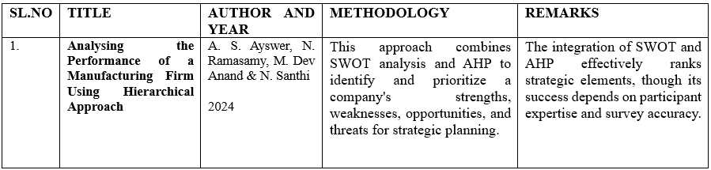
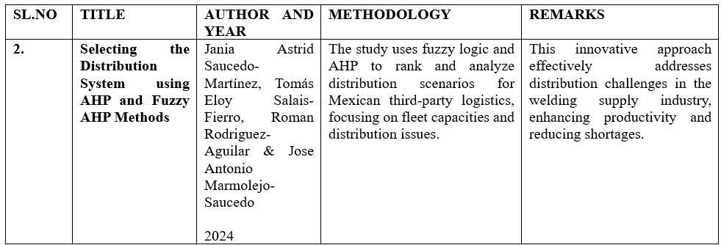
Literature Survey

Slide 4
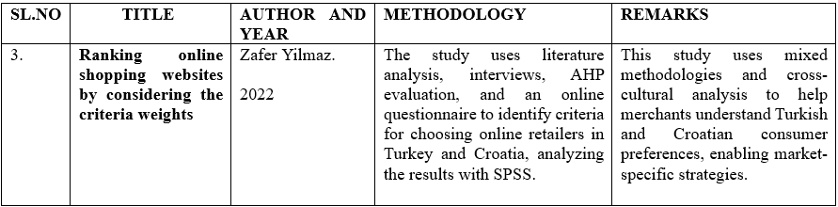
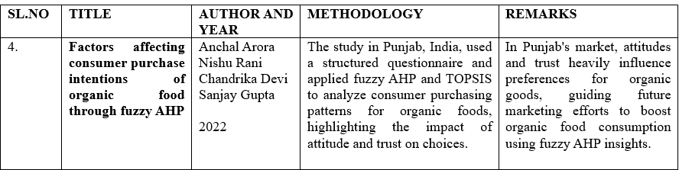
Literature Survey

Slide 5
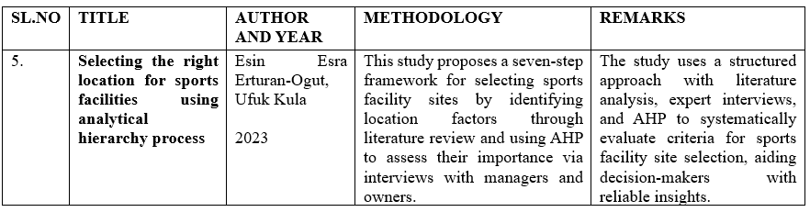
Literature Survey

Slide 6
Objective
01
02
To explore the key attributes that affect customer satisfaction and dealership performance, such as customer reviews, location proximity, facility convenience, trained manpower, product range, and after-sales service.
To investigate how various factors like showroom ambience, use of technology, and in-house service options contribute to the overall customer experience.
03
To find the critical success factors by comparing different dealerships using structured decision-making methods.

Slide 7
Objective
04
05
To analyze and rank dealerships based on their performance in customer experience and operational efficiency using AHP, Fuzzy, and Fuzzy TOPSIS.
To provide actionable insights and recommendations for improving dealership performance and customer satisfaction.

Slide 8

Methodology
Attribute Identification:
Identify and define the key attributes that influence customer satisfaction and operational efficiency in automotive dealerships. These attributes include customer reviews, location proximity, facility convenience, availability of trained manpower, product range, after-sales service, and others.
Data Collection:
Gather data related to these attributes from various sources such as customer feedback, industry reports, dealership records, and expert opinions.
AHP (Analytical Hierarchy Process):
Use AHP to structure the problem into a hierarchy of criteria and sub-criteria. Assign weights to each attribute based on their importance through pairwise comparisons, facilitating an understanding of the relative significance of each factor.

Slide 9
Methodology
Fuzzy Logic:
Apply fuzzy logic to handle uncertainty and imprecision associated with qualitative assessments. Fuzzy sets will be used to quantify subjective opinions, such as customer satisfaction levels and showroom ambience ratings.
Fuzzy TOPSIS:
Use Fuzzy TOPSIS to rank the dealerships by calculating their closeness to an ideal solution. This method will take into account both positive and negative aspects of each attribute, providing a comprehensive ranking of the dealerships.

Slide 10
Methodology
Analysis and Interpretation:
Analyze the results to identify the strengths and weaknesses of each dealership. Interpret the findings to provide actionable insights for enhancing customer experience and operational efficiency.
Recommendations:
Develop recommendations for dealerships to improve their performance in critical areas identified through the analysis.

Slide 11
Road Map
Phase 1
Phase 2
Phase 3
Phase 4
Phase 5
Phase 6
Preparation
and Planning
(weeks 1-4)
Attribute Identification
and Data Collection
(weeks 5-7)
Methodology Application
(Weeks 8-10)
Analysis and
Interpretation
(Weeks 11-13)
Recommendations
and Reporting
(Weeks 14-16)
Implementation
and Follow-up
(Weeks 17-19)

Slide 12
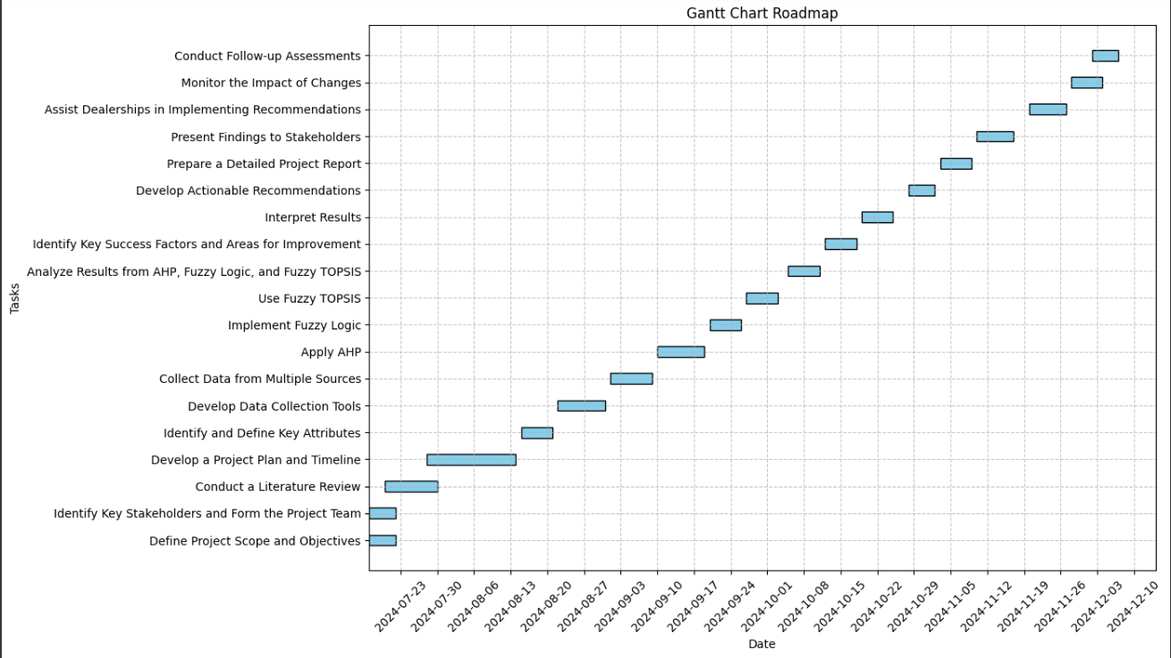
Road Map

Slide 13
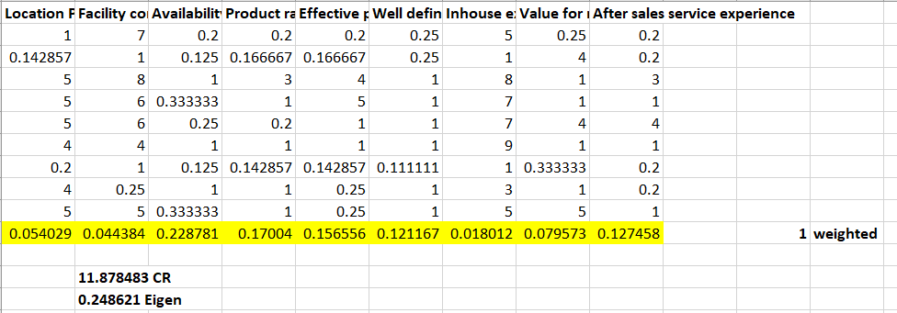
AHP Result

Slide 14
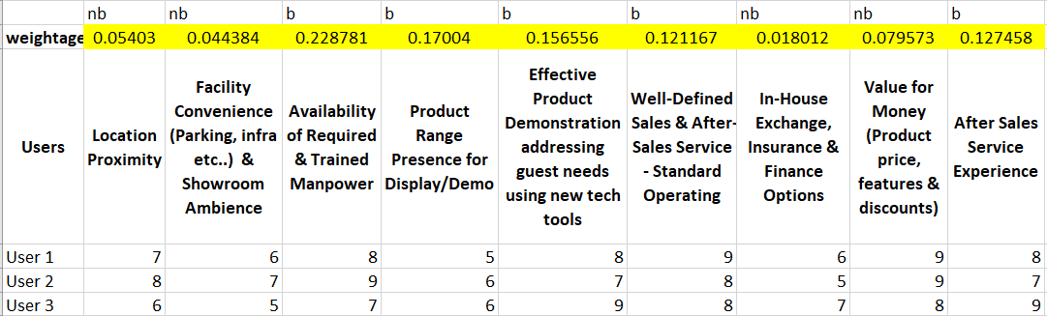
TOPSIS Data

Slide 15
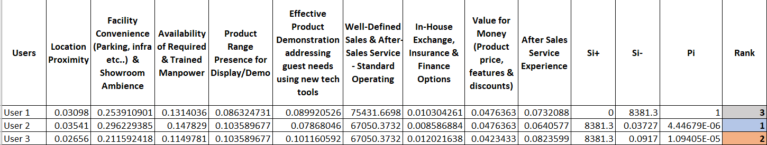
TOPSIS Result

Slide 16
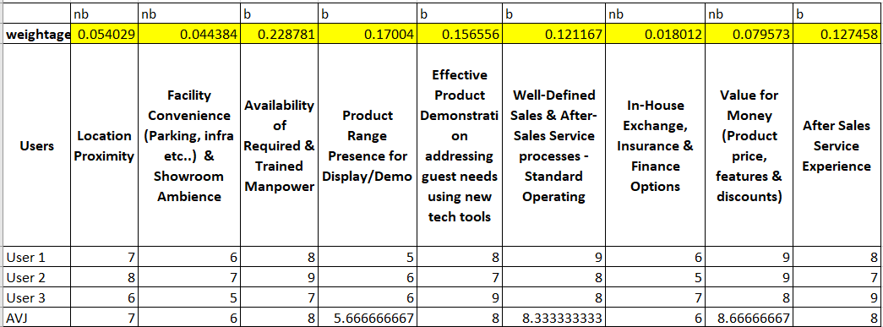
EDAS Data

Slide 17
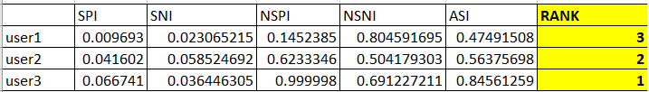
EDAS Result

Slide 18
References
1. Ayswer, A. S., Ramasamy, N., Anand, M., & Santhi, N. (2024). Analysing the Performance of a Manufacturing Firm Using Hierarchical Approach. Journal of The Institution of Engineers (India): Series C, 1-10.
2. Saucedo-Martínez, J. A., Salais-Fierro, T. E., Rodriguez-Aguilar, R., & Marmolejo-Saucedo, J. A. (2024). Selecting the Distribution System using AHP and Fuzzy AHP Methods. Mobile Networks and Applications, 1-8.
3. Yilmaz, Z. (2022). Ranking online shopping websites by considering the criteria weights. Journal of Business Research, 144, 497-512.
4. Arora, A., Rani, N., Devi, C., & Gupta, S. (2022). Factors affecting consumer purchase intentions of organic food through fuzzy AHP. International Journal of Quality & Reliability Management, 39(5), 1085-1103.
5. Erturan-Ogut, E. E., & Kula, U. (2023). Selecting the right location for sports facilities using analytical hierarchy process. Journal of Facilities Management, 21(5), 733-750.

